Slide 1
ADP 6-22
What the field should know about the new ADP 6-22
Basic leadership doctrine remains the same
Be – Know – Do, Leadership Requirements Model
“Go-to” source on what is expected of Army leaders and how to lead
New Title - Army Leadership and the Profession, replaces ADP 6-22 (2012), ADRP 6-22 (2012), and ADRP 1 (2015)
The Army Values define the Army Ethic
Actions described for the operational context while retaining applicability to all cohorts and all situations
Easier to understand
Quotes and vignettes in text and call-out boxes
New discussions on …
Dynamics of leadership – leaders adjust what they do based on the situation, their role and own capabilities, and the capabilities of those who they lead
Following – required by sworn oaths and the authority of those appointed over them
Humility – demonstration of right balance of confidence and knowledge of limits
Workload – ways leaders mitigate stresses of high workload
Counterproductive leadership – means to fail to lead IAW Army Values and LRM competencies; observable behaviors that undermine commitment and productivity, preferred term over toxic leadership (an attribution of a style)
Notes:
Dynamics of leadership – what leaders need to do …
Know how to assess tasks and conditions.
Know how to assess their own capabilities and those of their followers.
Know how to adjust their leadership techniques.
Know those they lead.
Understand how to employ the mission command approach to the situation.
Develop themselves and the competence of subordinates.
Establish and maintain positive leadership climates.
CPL – Categories of behaviors: Abusive, Self-serving, Erratic, Incompetent, Corrupt

Slide 2
ADP 6-22 Army Leadership and the Profession – key ideas
Applies to all Army leaders all the time
A trustworthy profession upon which the Nation relies
Produces outcomes needed for winning in LSCO
Combat power unifier and multiplier
Be-Know-Do
Leadership is influence
Leadership involves a wide range of behaviors
Leadership can be learned and improved
Leader attributes enable discretionary application of leadership
All leaders are also followers
What leaders should NOT be and do: counterproductive
Need to understand to apply in performance appraisals, development, assessment & counseling
Notes:
Authoritative reference - what Army leadership consists of and what is expected of all its leaders.
One-of-a-kind doctrine
Applies to all Army leaders all the time.
It is based on the principle that all leaders following the same activities of how to lead will be more effective when working together within and across organizations and within and across cohorts. It advocates that how you lead in Army schools, in garrison, during peacetime, and training will enable you to learn and improve your leadership to master the proficiency necessary for large scale combat operations.
It establishes that leadership is an activity that can be learned and improved. Its emphasis is on doing the right things in the right and ethical way adhering to the Army Values. Doing the right thing in the right way builds trust with each other and the American people – the intent of an Army Profession.
It recognizes that all leaders are also followers. Good leaders are good followers obeying legal and ethical orders and instructions and taking initiative within commander’s intent or last guidance received

Slide 3
ADP 6-22 Army Leadership and the Profession
The Army: a shared legacy to defend the Nation’s interests and its people
Army Profession: society’s trust that grants the Army relative autonomy with oversight
Army Leadership: purpose, direction, and motivation to accomplish the mission and improve the organization
Army Leadership Requirements Model: what leaders should be, know, and do
Leader Attributes (Be and Know): Army Values, Empathy, Warrior Ethos/Service Ethos, Discipline, Humility, Military Bearing/Professional Bearing, Fitness, Confidence, Resilience, Mental Agility, Judgment, Innovation, Interpersonal Tact, Expertise
Leadership Competencies (Do): Leads Others, Build Trust, Extends Influence, Leads by Example, Communicates, Prepares Self, Creates a Positive Environment, Develops Others, Stewards the Profession, Gets Results
Dynamics of Leadership: adaptation based on the leader, the led, and the situation
Roles and Levels of Leadership: similarities and difference by cohort and level
Leadership in Practice: special considerations during mission preparation and execution
Organizational Leadership: plans and synchronizing actions executed through subordinates
Strategic Leadership: shaping actions that set conditions for current and future success

Slide 4
ADP 6-22 Terms
The Army Profession is a vocation of Soldiers and DA Civilians whose collective expertise is the ethical design of, support to, and application of landpower; serving under civilian authority; and entrusted to defend the Constitution and the rights and interests of the American people.
Leadership is the activity of influencing people by providing purpose, direction, and motivation to accomplish the mission and improve the organization.
An Army leader is anyone who by virtue of assumed role or assigned responsibility inspires and influences people by providing purpose, direction, and motivation to accomplish the mission and improve the organization.
Counterproductive leadership is the demonstration of leader behaviors that violate one or more of the Army's core leader competencies or Army values, preventing a climate conducive to mission accomplishment.
Notes:
Prior definitions:
Army Profession – A unique vocation of experts certified in the ethical design, generation, support, and application of landpower, serving under civilian authority and entrusted to defend the Constitution and the rights and interests of the American people. (ADRP 1, 2015)
Leadership - The process of influencing people by providing purpose, direction, and motivation to accomplish the mission and improve the organization. (ADP 6-22, 2012)
Army leader - Anyone who by virtue of assumed role or assigned responsibility inspires and influences people to accomplish organizational goals. Army leaders motivate
people both inside and outside the chain of command to pursue actions, focus
thinking and shape decisions for the greater good of the organization. (ADP 6-22, 2012)
Counterproductive leadership can take different forms, from incompetence to abusiveness, all of which have detrimental impacts on individuals, the unit, and the accomplishment of the mission. Counterproductive leadership behaviors can span a range of behaviors to include bullying, distorting information, refusing to listen to subordinates, abusing authority, retaliating, blaming others, poor self-control (loses temper), withholding encouragement, dishonesty, unfairness, unjustness, showing little or no respect, talking down to others, behaving erratically, and taking credit for others’ work. (AR 600-100, 2017)

Slide 5
ADP 6-22 Logic Map
Army profession –
An Army demonstrating character, competence and commitment establishes trust with the Nation to allow the Army to operate autonomously with prudent oversight
Influence for mission and organization
Desired leader characteristics
An element of combat power -
Unifies and multiplies other elements
Relation to Command
LSCO
Multiple Outcomes

Slide 6
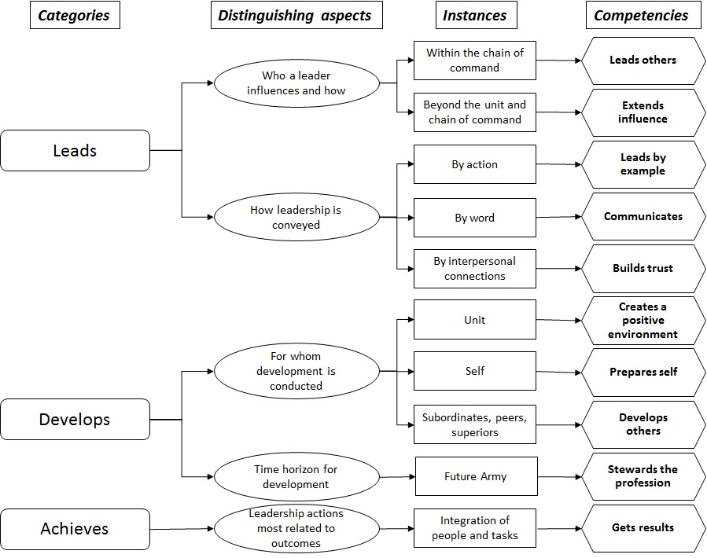
ADP 6-22 Army Leadership and the Profession
Competencies used in the model of leadership since 2006
Competency development
Designed to guide develop-ment, performance, administration
Incorporated historical trends
and review of combat success
Analysis of 200 skills sorted into set of competencies
Guided by panel of top experts in leader performance
Review & approval by Army LD stake-holders
3 rounds of Army-wide staffing
Continual validation
Comprehensive – favorable comparison to other models

