Slide 1
Accessing ATN Using Personal Devices
Via the Enterprise Access Management System-Army
(EAMS-A)
To use this tutorial you need to know your AKO user-name and password
8 April 2020
Training Management Directorate (TMD)
Fort Leavenworth, Kansas
Notes:
Soldiers and Leaders can now use their personal computers and hand held devices to access content on the Army Training Management (ATN) including the Individual Training page, the Army's Digital Job Book and the Small Unit Leader Tool, and the Live-Chat function via the Enterprise Access Management System-Army (EAMS-A) using their AKO user name and password.
This tutorial consists of two separate sections. The first section discusses how to access ATN using your using your Smart iPhone/Pad and/or Android phone. The second section discusses how to access via personal computer (PC).
If you do not have an AKO username and password, or need to reset it, see the Username and Password tutorial.
Next Slide

Slide 2
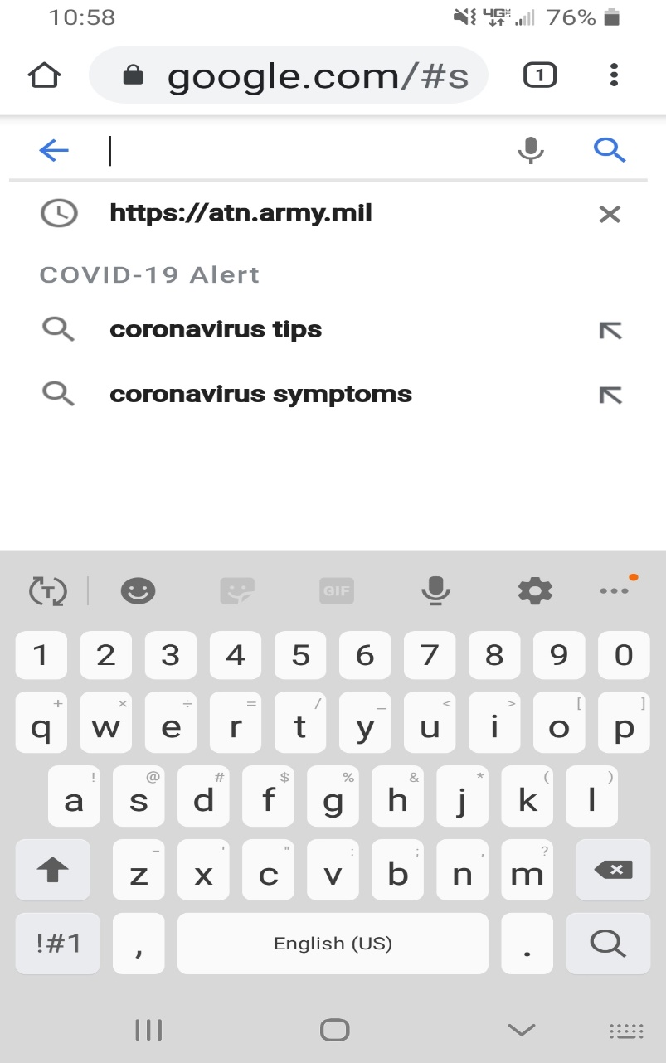
iOS Devises (iPhone or iPad)
HTTPS://ATN.ARMY.MIL
Open your cell phone browser and enter https://atn.army.mil in the address or search bar and enter
Notes:
Open your cell phone browser and type https://atn.army/mil into either the address bar or the search bar, then select enter.
Next Slide

Slide 3
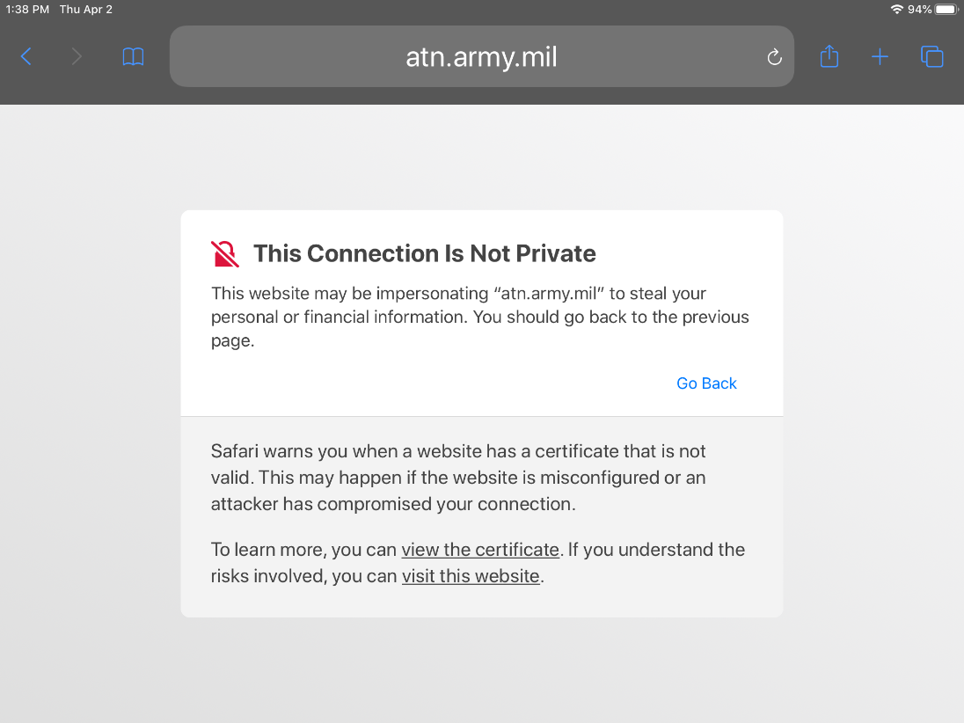
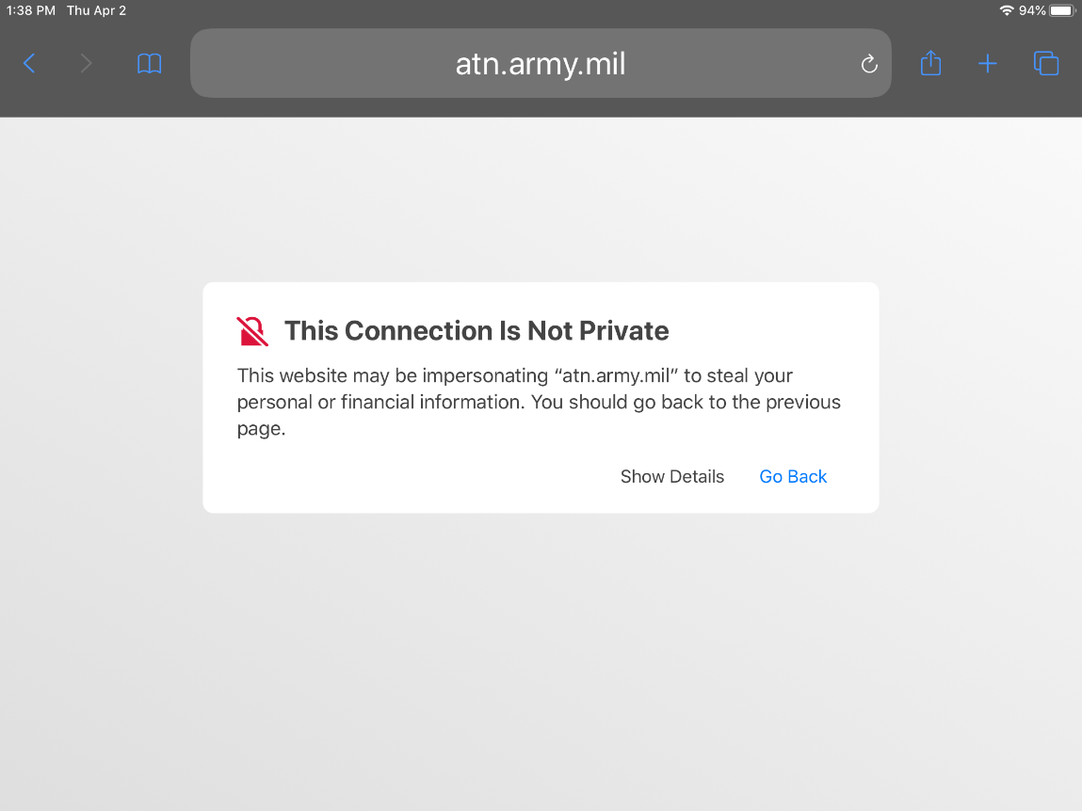
When accessing ATN on a personal iOS device (iPhone or iPad) for the first time, you may receive the below message:
Select the “visit this website” link
**You may have to repeat this process a second time depending on which type of operating system you use.
Select “Show Details”
In some cases your device’s browser security settings may need to be adjusted to allow pop-ups and/or fraudulent websites until you can add ATN as a favorite.
Notes:
When accessing ATN on a personal iOS device (iPhone or iPad) for the first time you may receive the Connection is not private message.
Select the “Show Details” button and another window will open. Select the “visit the website” link. You may have to go through the process twice to get your device to allow a visit the website. Select the “visit the website” link again, as needed.
In some cases your device’s browser security settings may need to be adjusted to allow pop-ups and/or fraudulent websites until you can add ATN as a favorite.
Next Slide

Slide 4
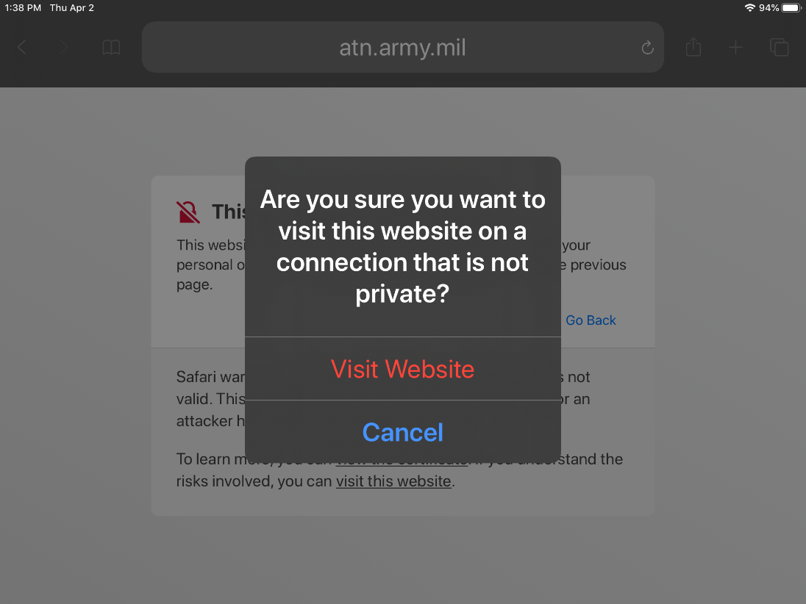
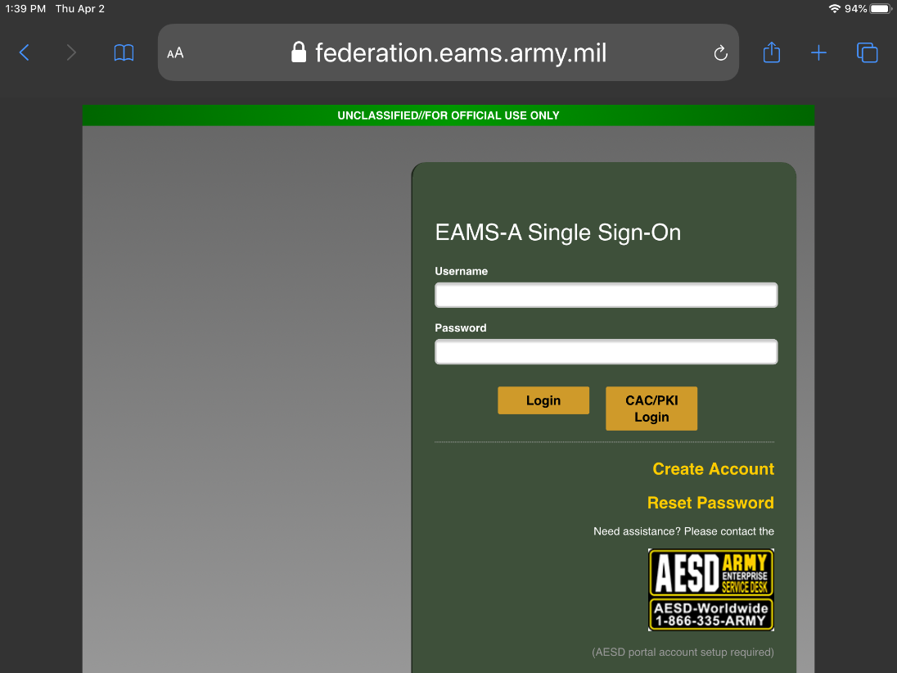
Select Visit Website
A pop-up window appears, where you will select the “Visit Website” link again.
This will bring you to the ATN Sign-On page where you can enter your AKO Username/Password for access.
If you have questions on resetting your AKO password for ATN access please refer to the tutorial or contact our Help Desk: (913) 684-4000 or Toll Free: (877) 241-0347
Notes:
A pop-up window appears, where you will select the “Visit Website” Llink again.
This will bring you to the ATN Sign-On page where you can enter your AKO Username/Password for access.
Next Slide

Slide 5
Android Devices
HTTPS://ATN.ARMY.MIL
Open up your cell phone browser and enter https://atn.army.mil in the address or search bar and enter
Notes:
Open your cell phone browser and type https://atn.army/mil into either the address bar or the search bar, then select enter.
Next Slide

Slide 6
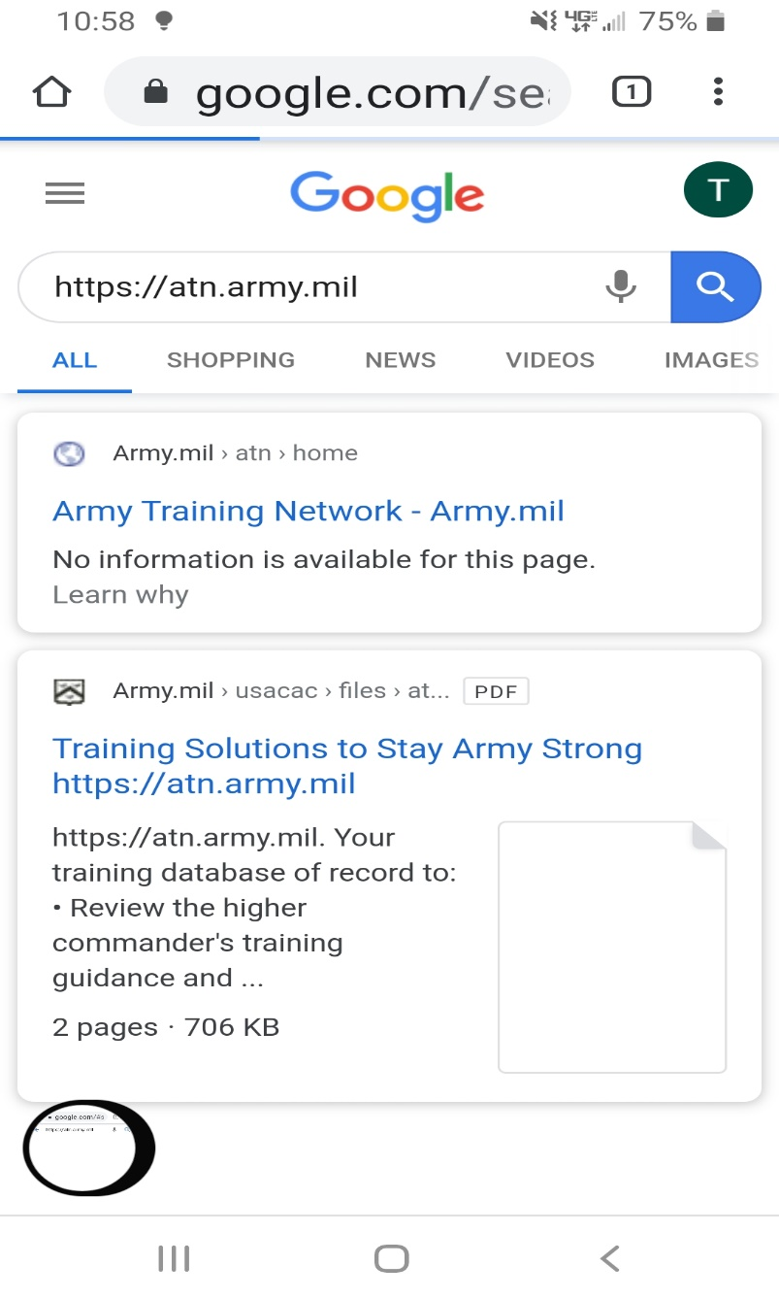
HTTPS://ATN.ARMY.MIL
Select the search function and the
Army Training Network URL
Notes:
Your browser will open and you will have to select which website to go to. Select the Army Training Network URL.
Next Slide

Slide 7
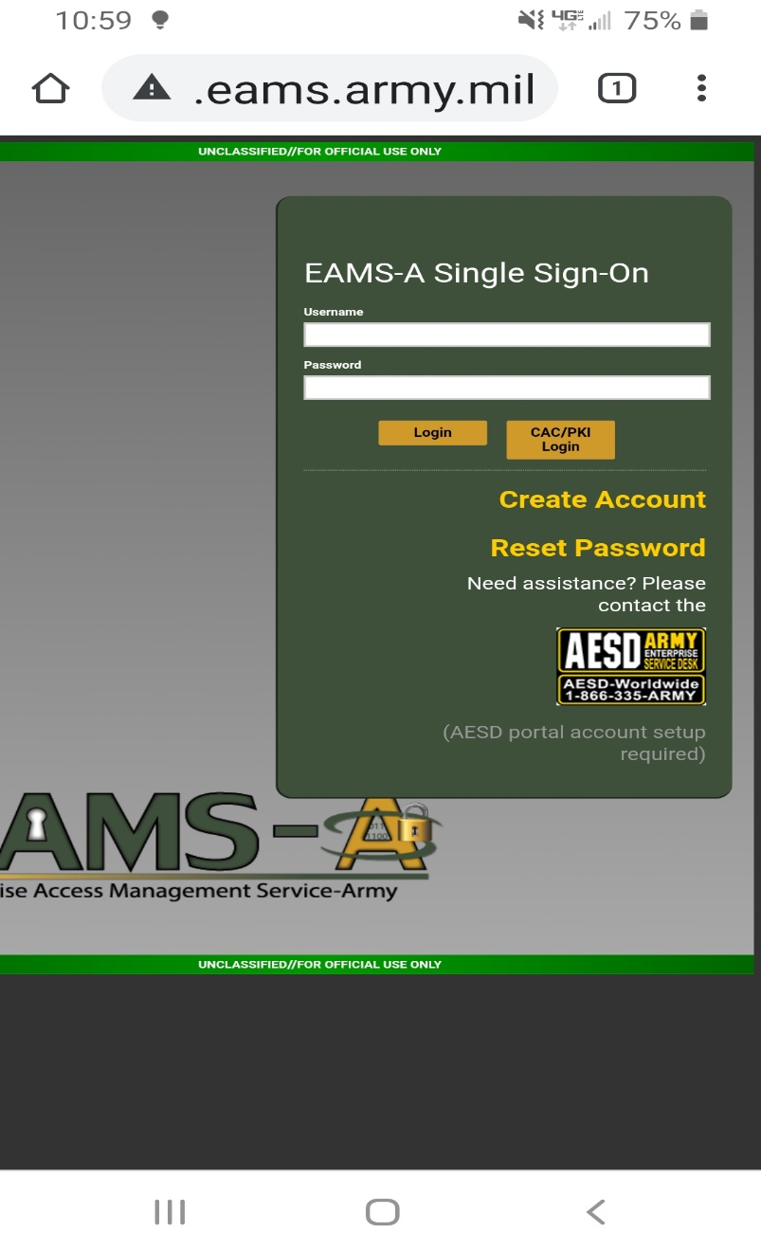
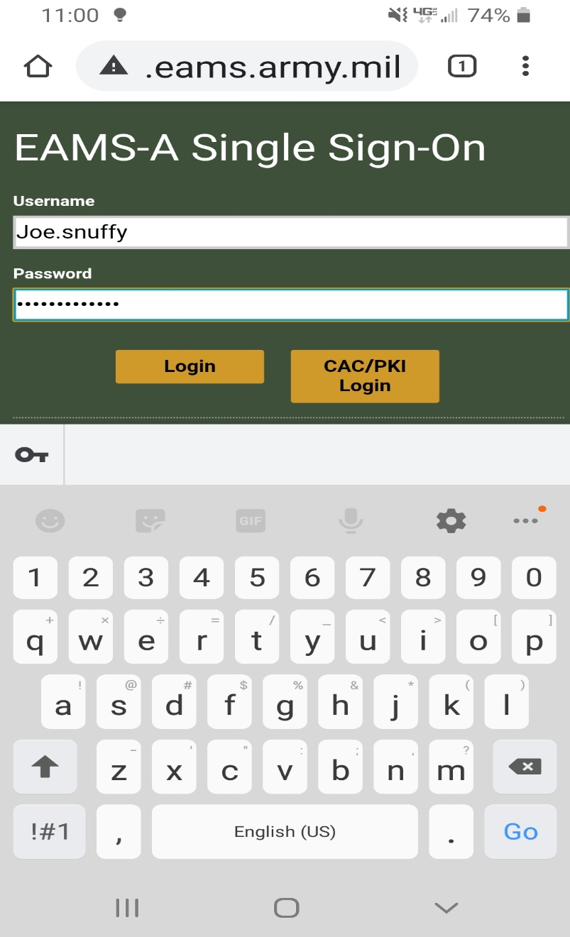
Enter your Username and Password
Select Login
Notes:
Enter your AKO username and password, then select Login.
Next Slide

Slide 8
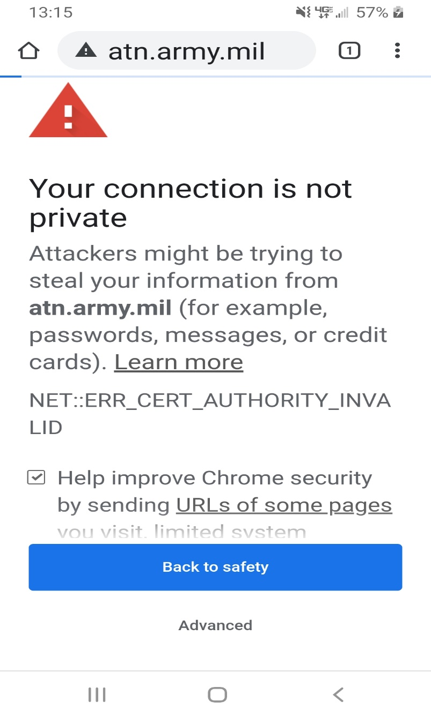
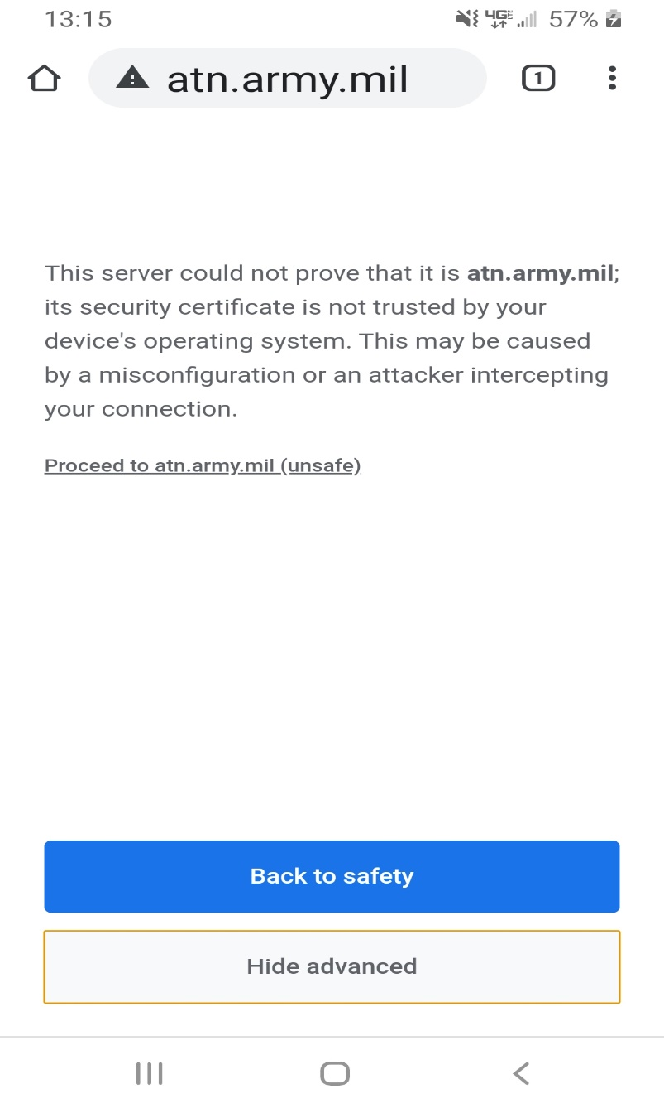
Select Advanced if you receive this pop up
Select Proceed to atn.army.mil (unsafe)
Notes:
A warning may appear on your cell phone so select advanced. When the next page opens select Proceed to atn.army.mil (unsafe).
Next Slide

Slide 9
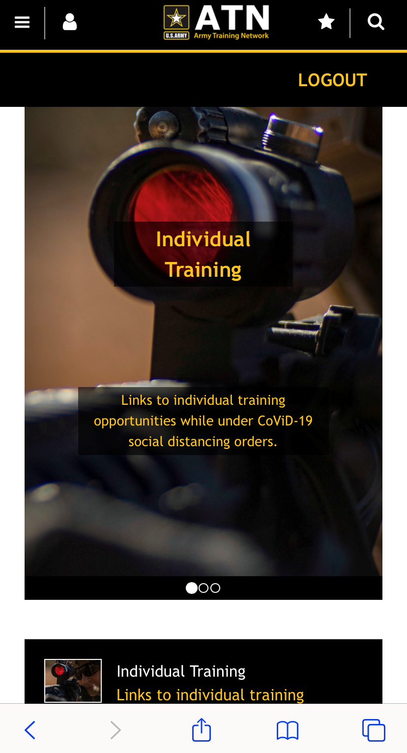
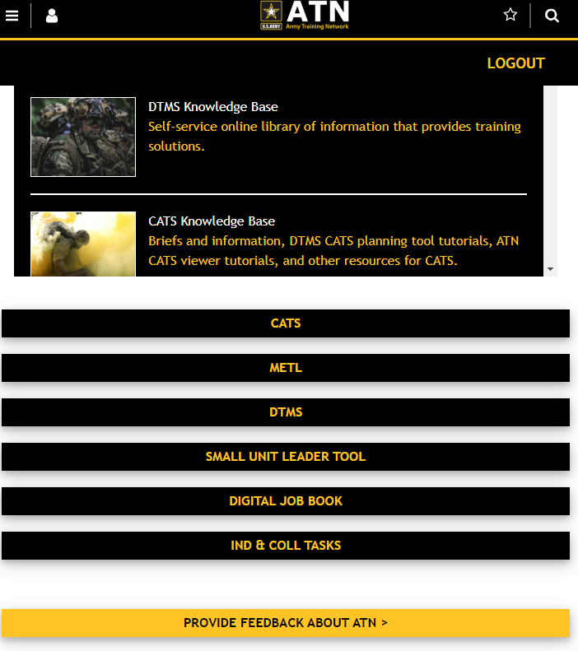
ATN Homepage opens
Notes:
Once the ATN Homepage open you may have to scroll down until you see the content you wish to use.
The next page that will open will be the homepage for the your selection.
Next Slide

Slide 10
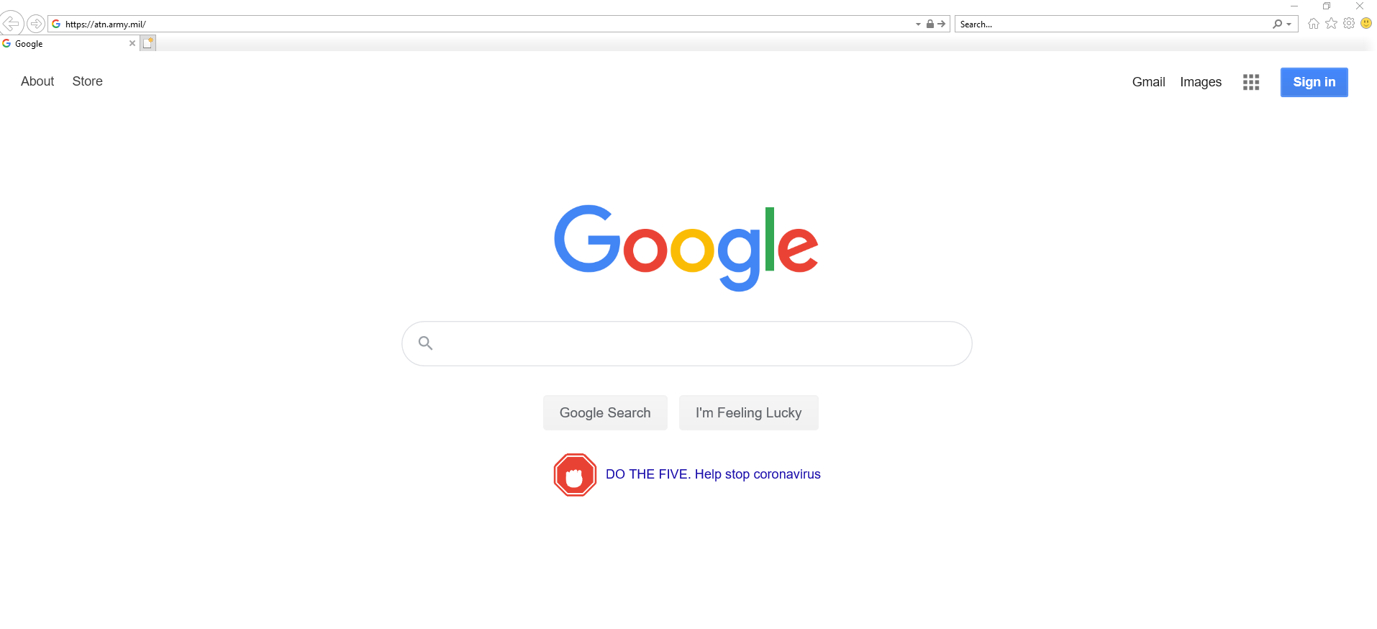
Personal Computers
HTTPS://ATN.ARMY.MIL
NOTE: Internet Explorer is the approved browser for use on government systems
Open browser and enter https://atn.army.mil in the address or search bar and enter
Notes:
Using your personal computer open Internet Explorer and type https://atn.army/mil into either the address bar of the search bar and select enter.
NOTE: Internet Explorer is the approved browser for use on government systems.
Next Slide

Slide 11
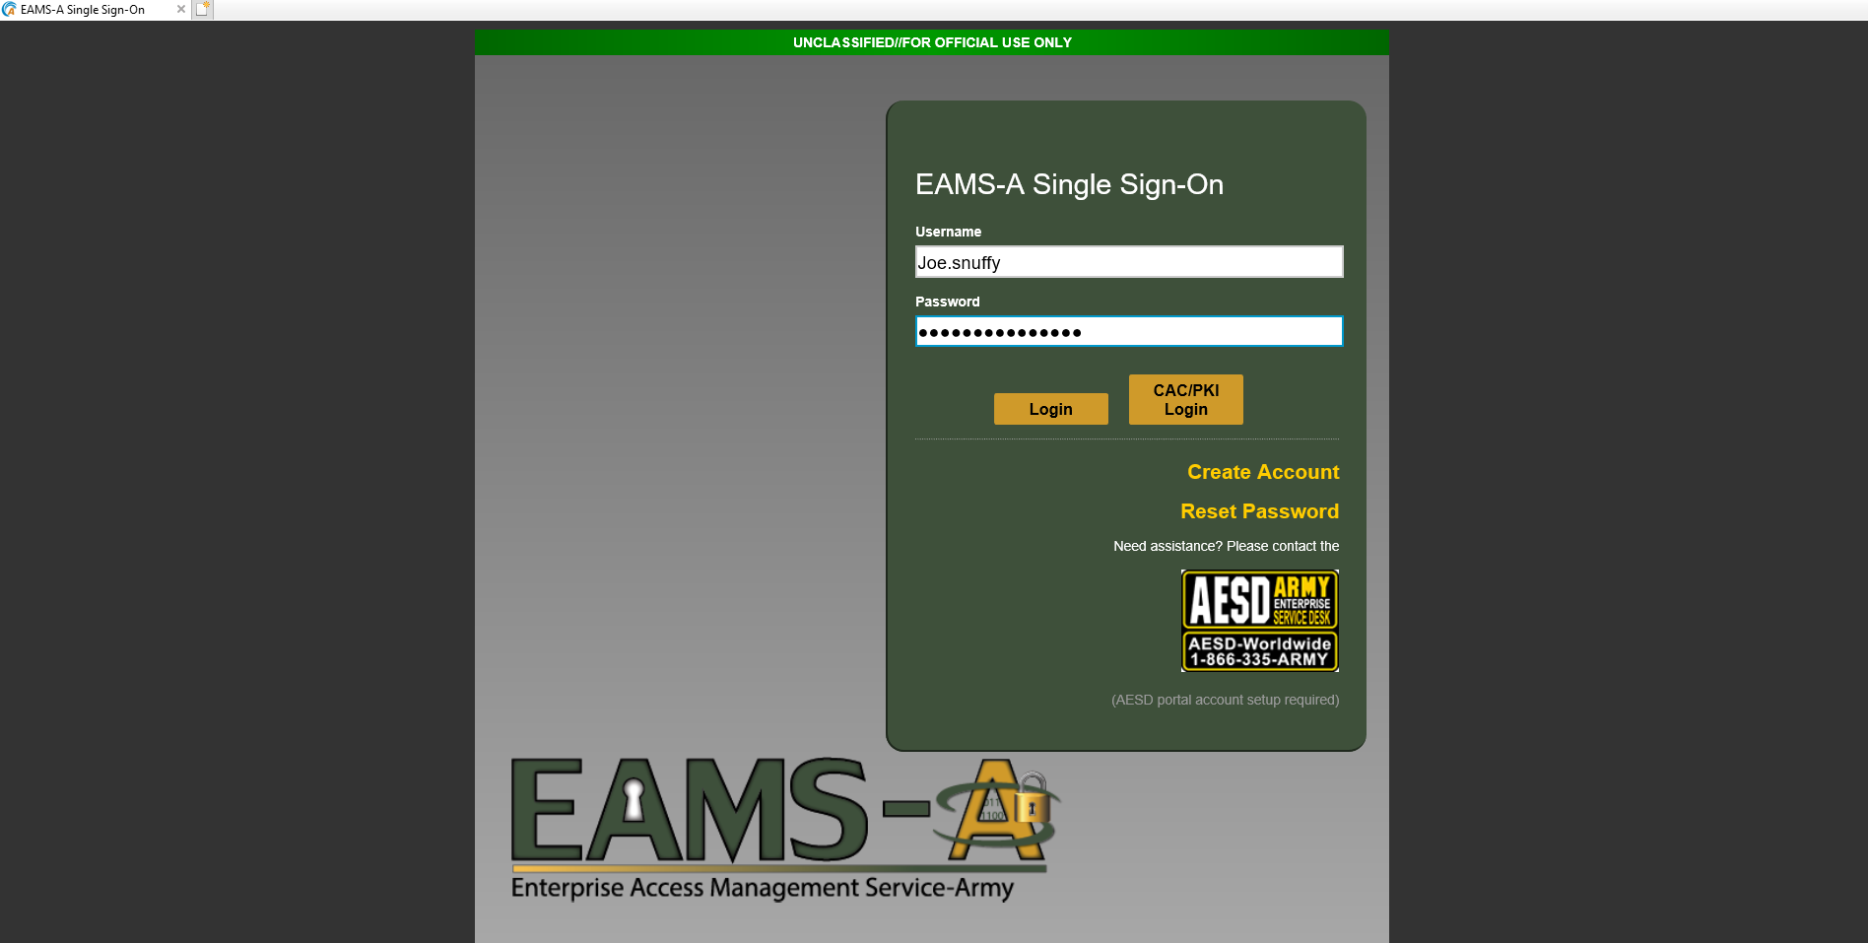
Enter your Username and Password
Select Login
Refer to the Username and Password tutorial to establish or reset your username and password
Notes:
Enter your AKO username and password, then select Login.
Do not use the Create Account or Reset Password tabs to establish or reset your AKO username and password. Reference Establishing Your EAMS-A Username and Password tutorial.
Next Slide

Slide 12
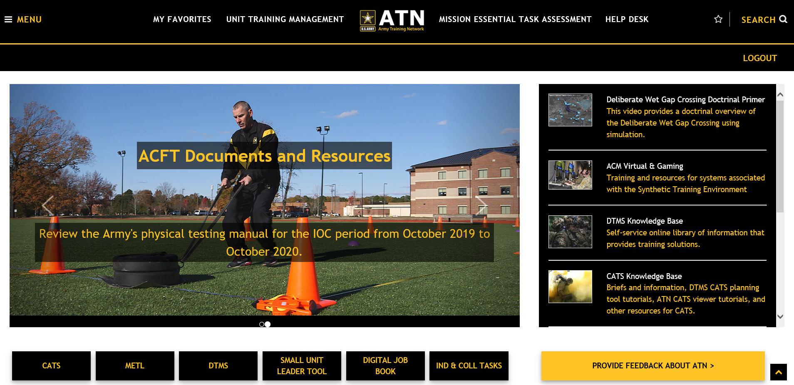
Select Tools or Features
to open their webpage
Notes:
The ATN homepage will open and you can find the content you wish to use
If you have not been granted permissions by you Company level DTMS Manager, the Small Unit Leader Tool will not be available.
Next Slide

Slide 13
This concludes the tutorial.
ATMS Help Desk:
Comm: (913) 684-2700
DSN: 552-2700
Toll Free: 877-241-0347
usarmy.leavenworth.cac.mbx.dtmshd@mail.mil
Notes:
This concludes the Personal Devices tutorial. Please contact our Help Desk for any further questions or issues logging on from your personal device.
NOTE** Army Training Management System (ATMS) Help Desk:
(913) 684-2700 or email us directly
usarmy.leavenworth.cac.mbx.dtmshd@mail.mil

