Slide 1
How to Add ATN to your Personal Device Home Screen (iPhone, iPad or Android)
To use this tutorial you need to know your AKO user-name and password
2 Sep 2020
Training Management Directorate (TMD)
Fort Leavenworth, Kansas
Notes:
Did you know that you can have your favorite websites like ATN at your fingertips, alongside other apps, on the home screen of your iPhone, iPad or iPod Touch – without having to download an app? Here’s a simple tutorial to show you how:
Next Slide

Slide 2
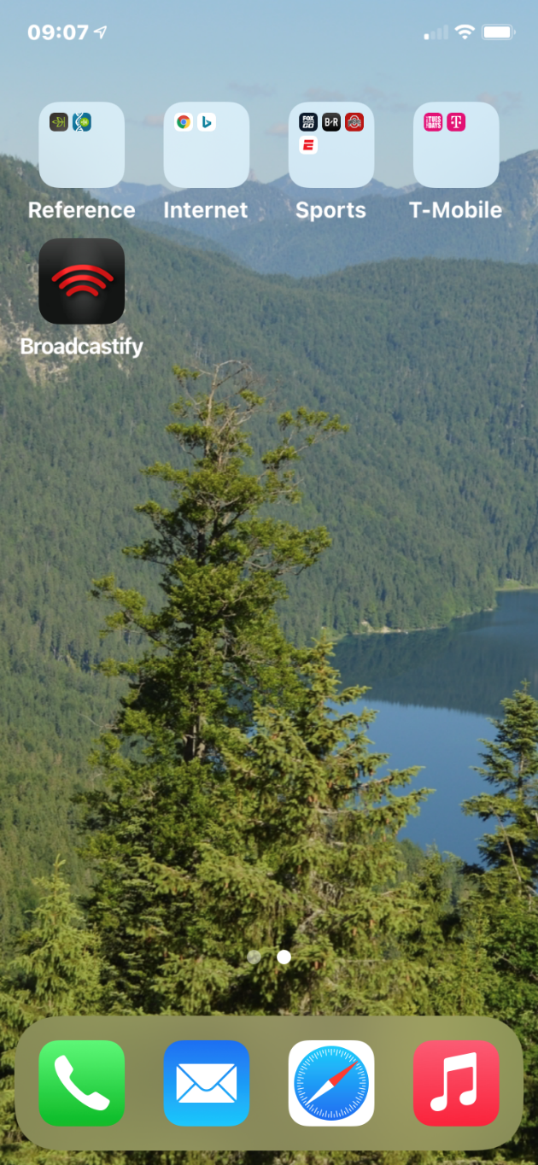
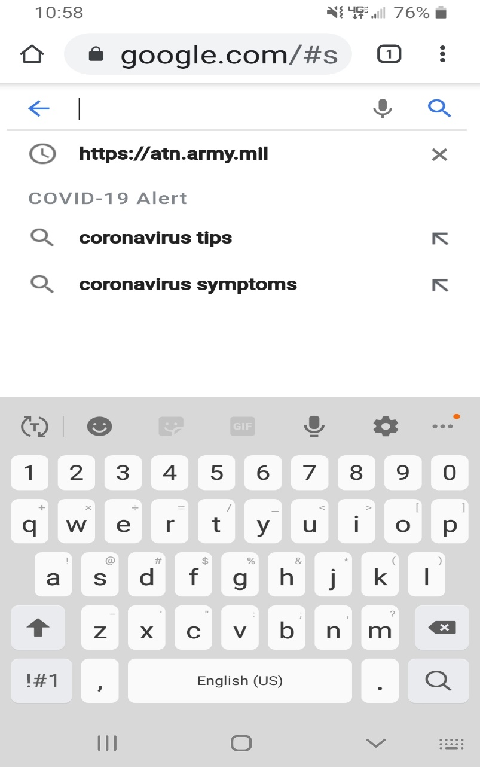
iOS Devices (iPhone or iPad)
HTTPS://ATN.ARMY.MIL
Open your cell phone browser and enter https://atn.army.mil in the address or search bar and enter
Notes:
Launch the Safari browser (it doesn’t work on Chrome) and navigate to the ATN web page you want to add to your home screen https://atn.army.mil. Enter your EAMS-A Login and Password to login.
Next Slide

Slide 3
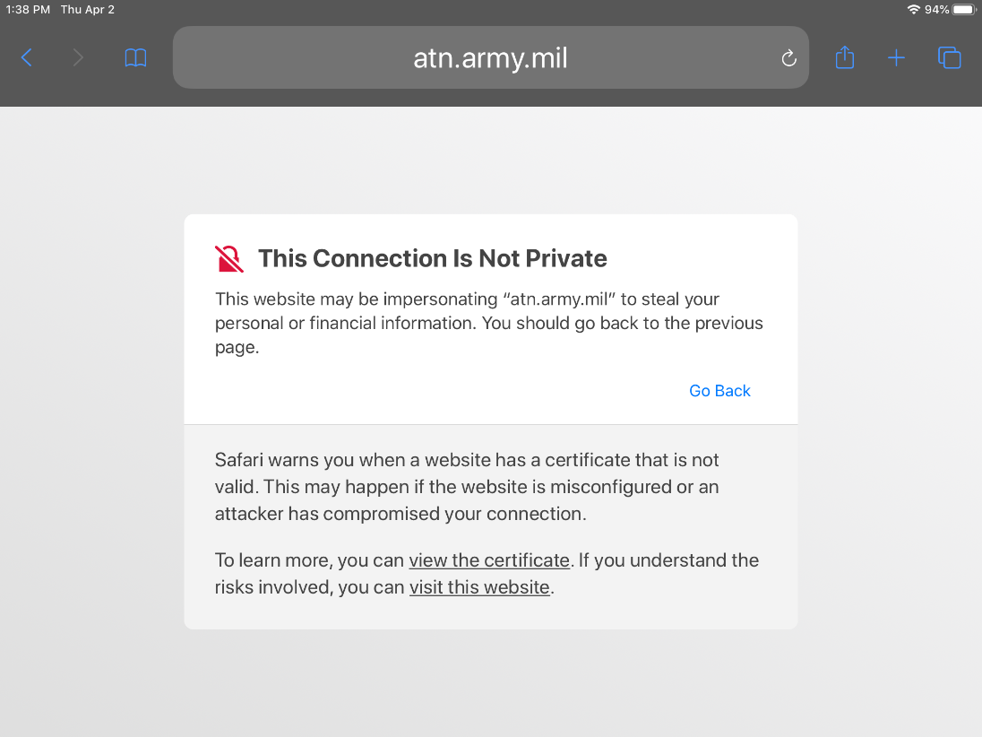
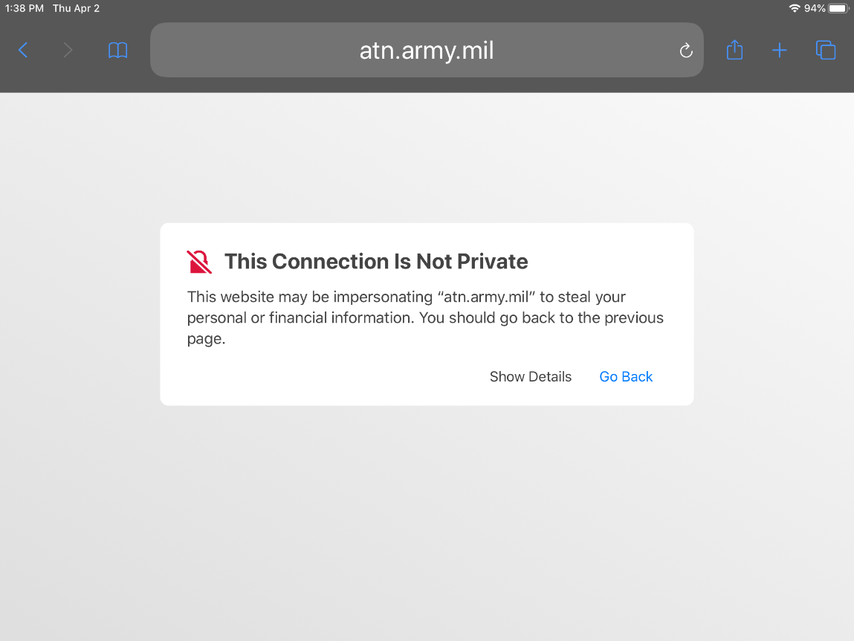
When accessing ATN on a personal iOS device (iPhone or iPad) for the first time, you may receive the below message:
Select the “visit this website” link
**You may have to repeat this process a second time depending on which type of operating system you use
Select “Show Details”
In some cases your device’s browser security settings may need to be adjusted to allow pop-ups and/or fraudulent websites until you can add ATN as a favorite
Notes:
When accessing ATN on a personal iOS device (iPhone or iPad) for the first time you may receive the Connection is not private message.
Select the “Show Details” button and another window will open. Select the “visit the website” link. You may have to go through the process twice to get your device to allow a visit the website. Select the “visit the website” link again, as needed.
In some cases your device’s browser security settings may need to be adjusted to allow pop-ups and/or fraudulent websites until you can add ATN as a favorite.
Next Slide

Slide 4
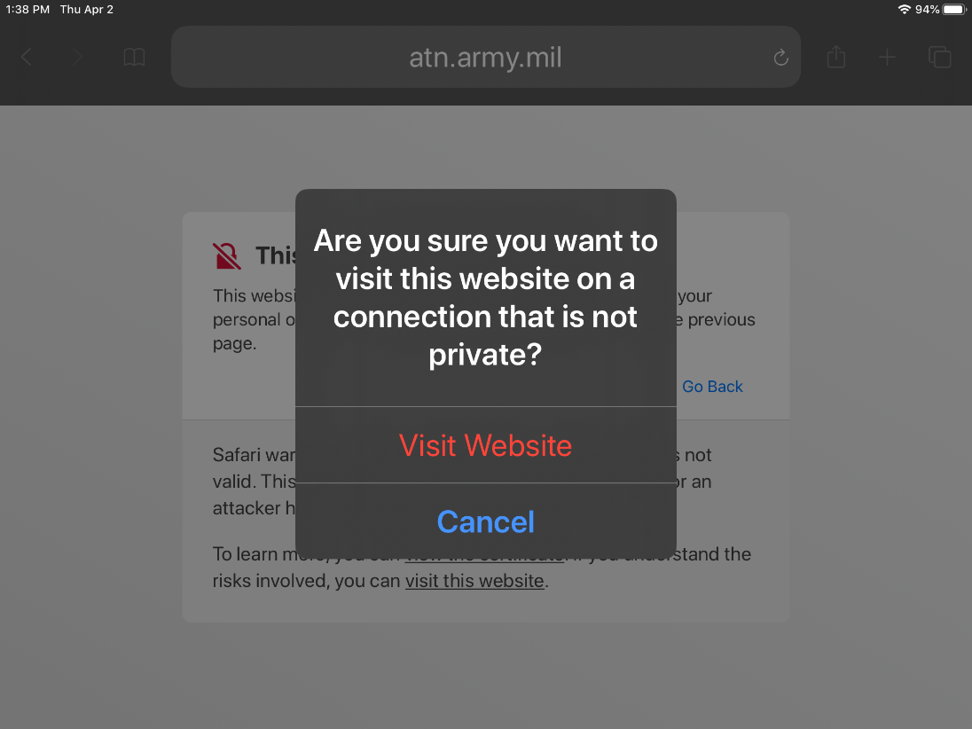
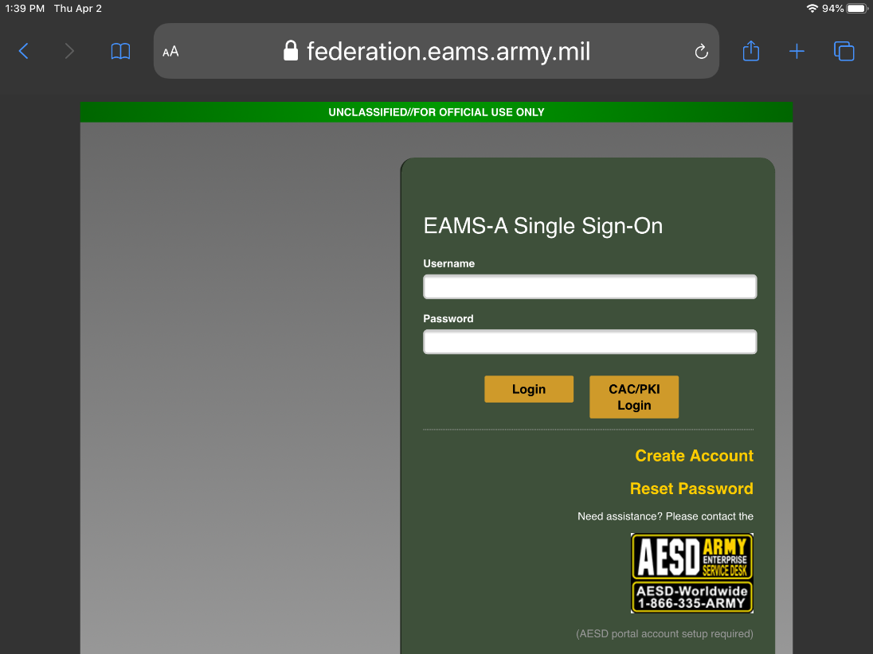
Select Visit Website
A pop-up window appears, where you will select the “Visit Website” link again
This will bring you to the ATN Sign-On page where you can enter your AKO Username/Password for access
If you have questions on resetting your AKO password for ATN access, please refer to the tutorial
Universal Username and Password Guide https://atn.army.mil/digital-job-book/digital-job-book or
contact our Help Desk: (913) 684-4000 or Toll Free: (877) 241-0347
Notes:
A pop-up window appears, where you will select the “Visit Website” Link again.
This will bring you to the ATN Sign-On page where you can enter your AKO Username/Password for access.
Next Slide

Slide 5
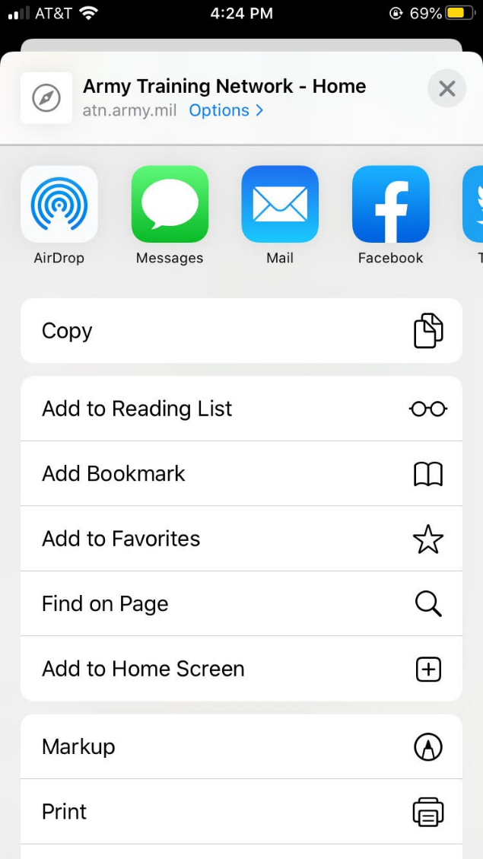
Select Add to Home Screen
ATN Homepage opens
Select The Share Button
Notes:
Once the ATN Homepage opens up, tap the “share” button on your browser’s toolbar (it’s the rectangle with an arrow pointing up.) You’ll find this at the top of an iPad screen, and at the bottom of an iPhone or iPod Touch screen.
A new menu appears. Look for and select the “Add to Home Screen” icon.
Next Slide

Slide 6
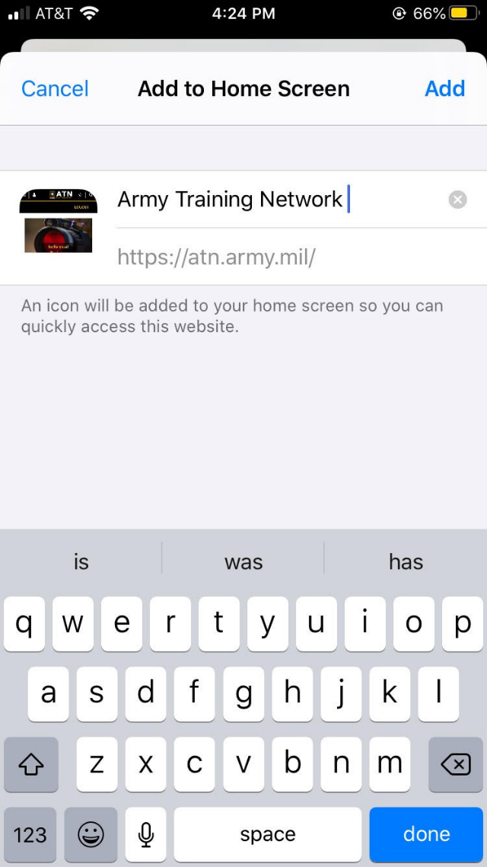
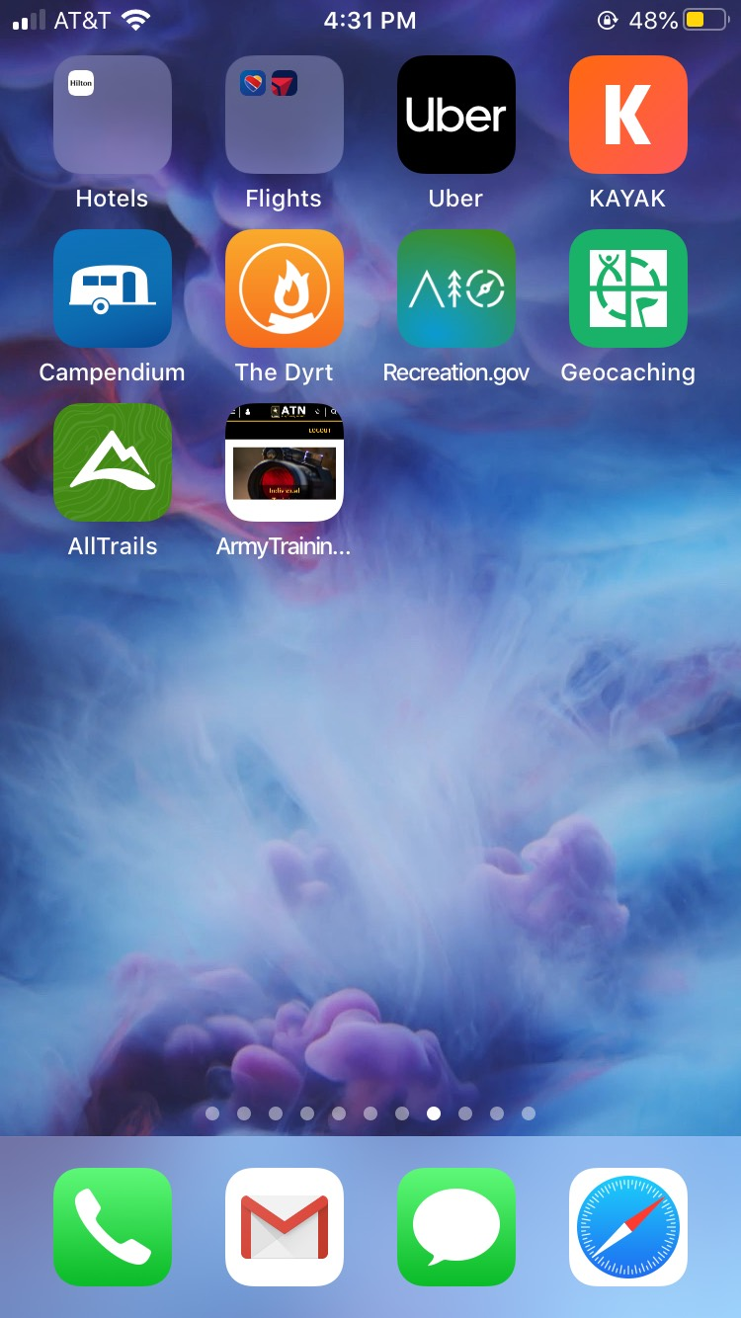
Rename the shortcut or leave the name as is
The website shortcut has been added to your home screen
Notes:
A new window opens up, where you can name the shortcut before tapping the “Add” button. In this case, we would leave the name Army Training Network.
The website shortcut has been added to your home screen (see Army Training Network at the top right of screen above), looks just like the ATN page you saved, and can be dragged around and placed anywhere, just like your other app icons.
Next Slide

Slide 7
Android Devices
HTTPS://ATN.ARMY.MIL
Open up your cell phone browser and enter https://atn.army.mil in the address or search bar and enter
Notes:
Open your cell phone browser and type https://atn.army/mil into either the address bar or the search bar, then select enter.
Next Slide

Slide 8
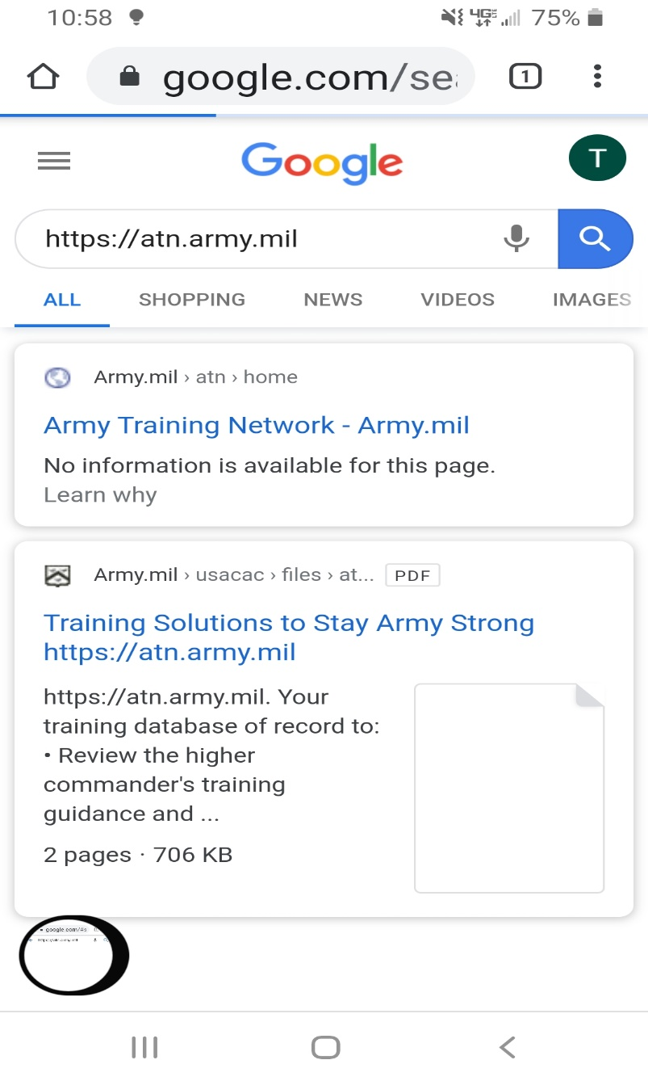
HTTPS://ATN.ARMY.MIL
Select the search function and the
Army Training Network URL
Notes:
Your browser will open and you will have to select which website to go to. Select the Army Training Network URL.
Next Slide

Slide 9
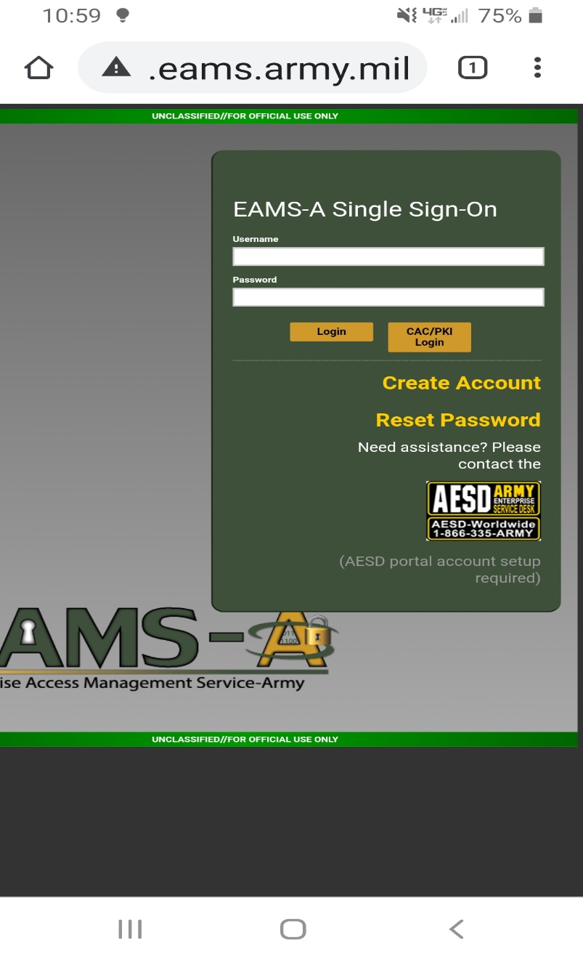
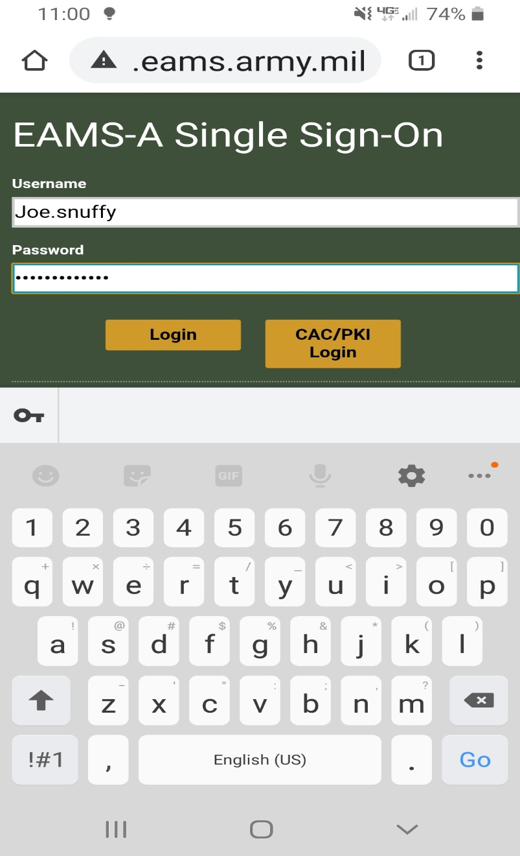
Enter your Username and Password
Select Login
Notes:
Enter your AKO username and password, then select Login.
Next Slide

Slide 10
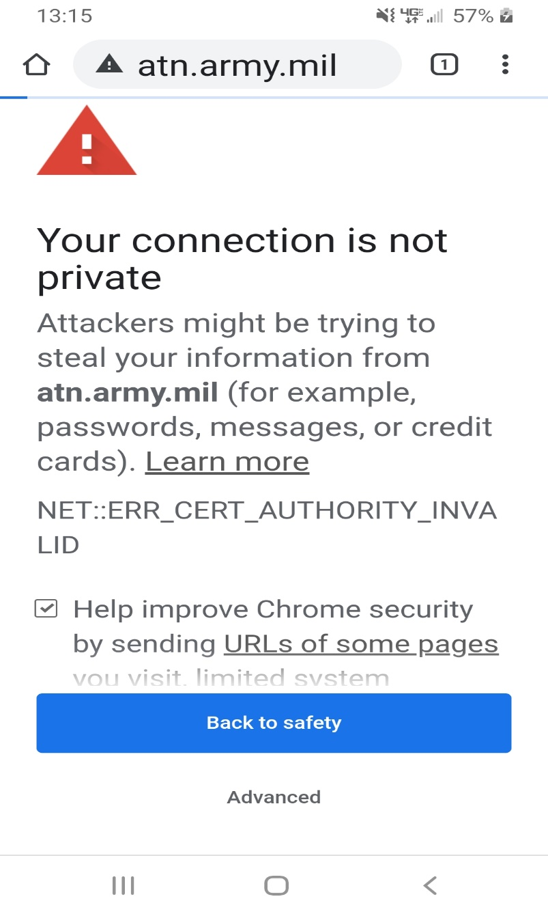
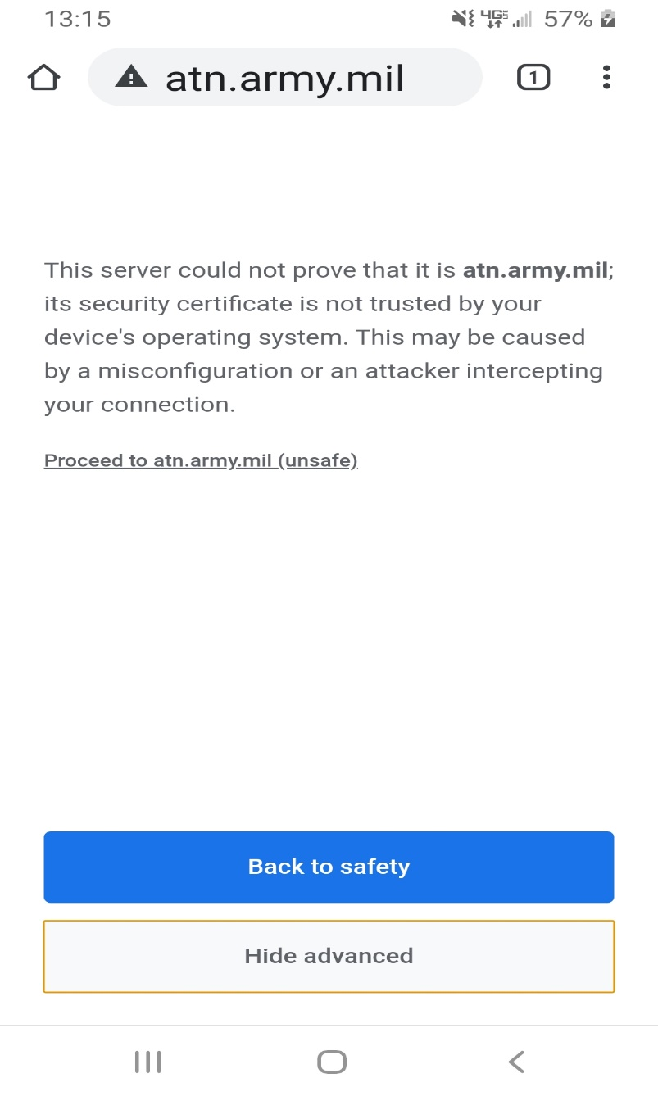
Select Advanced if you receive this pop up
Select Proceed to atn.army.mil (unsafe)
Notes:
A warning may appear on your cell phone so select advanced. When the next page opens select Proceed to atn.army.mil (unsafe).
Next Slide

Slide 11
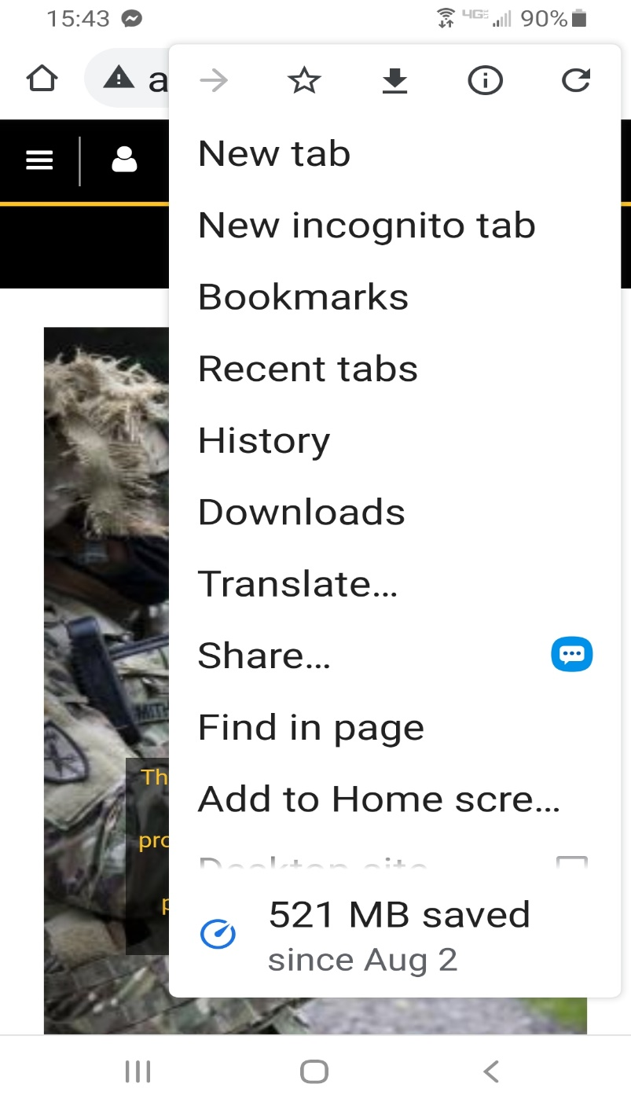
ATN Homepage opens
Select the three dot menu option
Select Add to Home Screen
Notes:
Once the ATN Homepage select the three dot menu option.
Select Add to Home screen from the drop down menu.
Next Slide

Slide 12
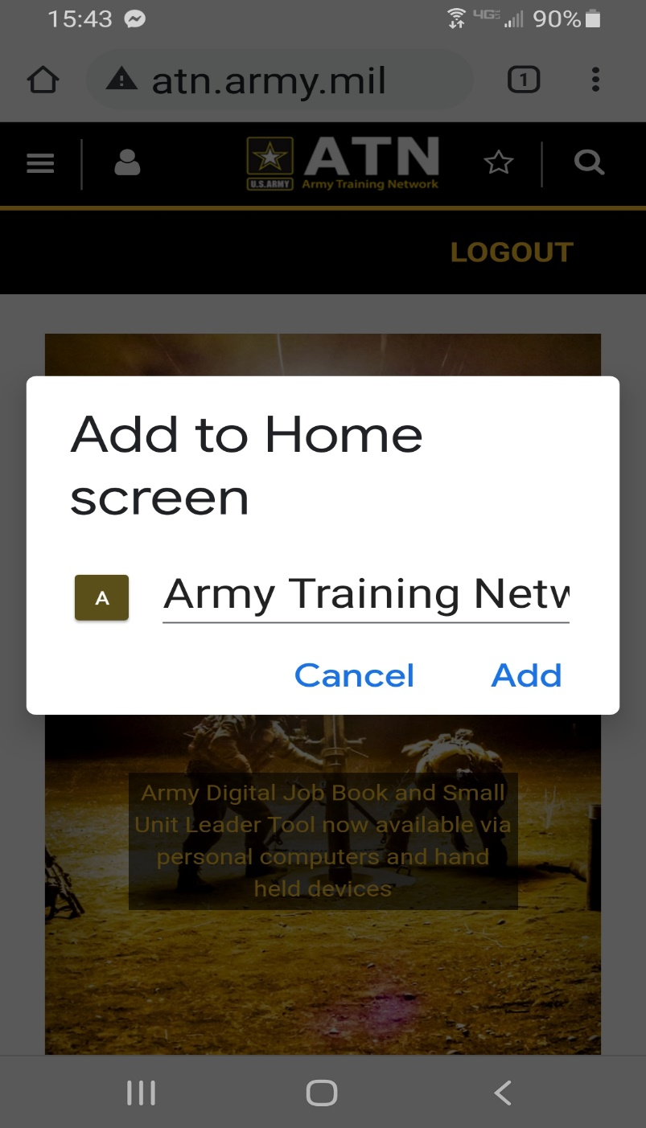
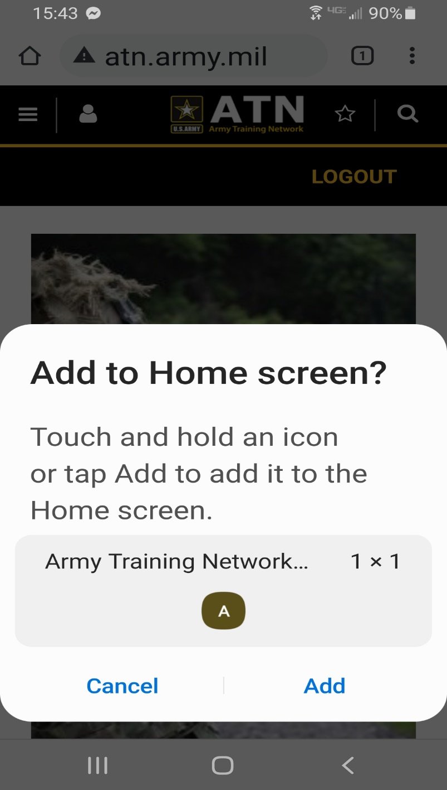
Touch and hold an icon or select Add to add it to the Home screen
Rename the shortcut or leave the name as is
Notes:
A new window opens up, where you can name the shortcut before tapping the “Add” button. In this case, we would leave the name Army Training Network.
Touch and hold an icon or select the Add button to add it to the Home screen.
The website shortcut has been added to your home screen (see Army Training Network at the top right of screen above), looks just like the ATN page you saved, and can be dragged around and placed anywhere, just like your other app icons.
Next Slide

Slide 13
The website shortcut has been added to your home screen
Notes:
The website shortcut has been added to your home screen (see Army Training Network in the upper left of screen above), looks just like the ATN page you saved, and can be dragged around and placed anywhere, just like your other app icons.

Slide 14
This concludes the tutorial.
ATMS Help Desk:
Comm: (913) 684-2700
DSN: 552-2700
Toll Free: 877-241-0347
usarmy.leavenworth.cac.mbx.dtmshd@mail.mil
Notes:
This concludes the Personal Devices tutorial. Please contact our Help Desk for any further questions or issues logging on from your personal device.
NOTE** Army Training Management System (ATMS) Help Desk:
(913) 684-2700 or email us directly
usarmy.leavenworth.cac.mbx.dtmshd@mail.mil

