Slide 1
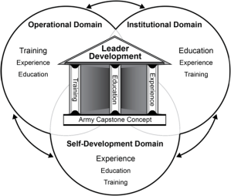
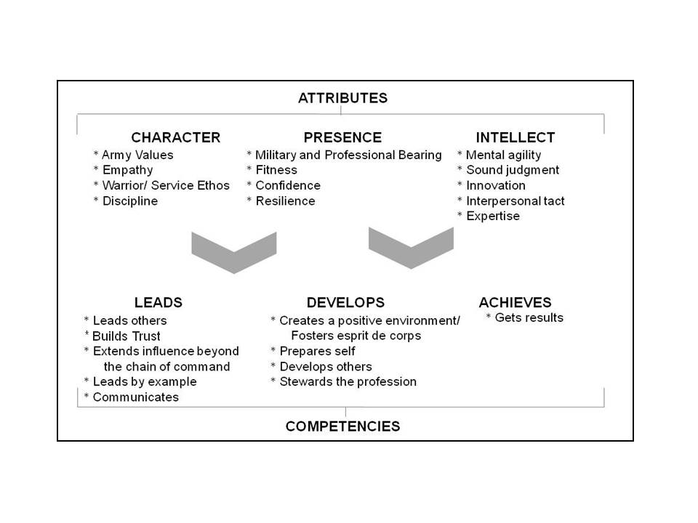
Leader Development
Organization & Functions
CENTER FOR ARMY
LEADERSHIP (CAL)
OUR SYSTEMS AND PROCESSES
Army Leader Development Model
WHAT ARE WE DEVELOPING IN LEADERS
Army Leadership Requirements Model
Army Homepage: http://www.army.mil/
Army Knowledge Online (AKO): www.us.army.mil
Army Learning Management System (ALMS):
https://www.lms.army.mil/Saba/Web/Main
Army Training and Certification Tracking System (ATCTS):
https://atc.us.army.mil
Army Training Network (ATN): https://atn.army.mil
Center for Army Leadership: http://usacac.army.mil/cac2/CAL
Commissioned Officer Professional Development and
Career Management (DA PAM 600-3):
www.apd.army.mil/pdffiles/p600_3.pdf
DA Photo Management Information System (DAPMIS):
https://knoxhrc16.hrc.army.mil/dapmis
Digital Army Library Service (DALS):
http://www.libraries.army.mil
Federal Voting Assistance Program:
http://www.fvap.gov/index.html
Gold Book (Army 2020 Generating Health & Discipline in
the Force): Http://www.army.mil/article/72086
Human Resources Command: www.hrc.army.mil
IPERMS: https://iperms.hrc.army.mil/rms/login-paa
LandWarNet eUniversity: https://lwn.army.mil
MyArmyBenefits: http://myarmybenefits.us.army.mil
MyPay: https://mypay.dfas.mil/mypay.aspx
Officer Record Brief (ORB):
https://knoxhrc16.hrc.army.mil/SSORB/
Promotions Branch Home Page:
https://www.hrc.army.mil/TAGD/Promotions%20Branch%20Home%20Page
Thrift Savings Plan: https://www.tsp.gov/index.shtml
USACR/Safety Center: https://safety.army.mil/Default.aspx
United States Army Combined Arms Center:
http://usacac.army.mil/CAC2/index.asp
The Center for Army Leadership (CAL), Combined Arms Center (CAC), located at Fort Leavenworth, KS, conducts leadership and leader development research, studies, analysis, assessment and evaluation; provides the Army leadership and leader development doctrine, products and services; develops and maintains the Army Leader Development Strategy and annexes; and manages the Army Leader Development Program
FUNCTIONS:
Army lead for leadership doctrine and leadership development.
Conduct research and studies to identify leader development trends, requirements, and to develop and promote leadership and leader development practices and techniques.
Execute the Army Multi-Source Assessment and Feedback Program, to include developing and maintaining leadership learning products in the Virtual Improvement Center (VIC).
Manage the Army Leader Development Program.
Develop and maintain Army Leader Development Strategy and any supporting annexes.
Develop and execute leadership and leader development quality assurance program.
CAC lead for L-domain (leadership component) integration, synchronization and evaluation across DOTMLPF activities and requirements.
Develop & manage leadership & leader development products & services.
Center for
Army Leadership
HQ/
Operations
Quality
Assurance
Leadership
Research,
Assessment &
Doctrine Division
Army
Leader
Development
Division
AR 350-1
http://usacac.army.mil/cac2/CAL/
MISSION:
Conducts leadership and leader development research, studies, analysis, assessment and evaluation
Provides the Army Leadership and leader development doctrine, products and services
Develops and maintains the Army Leader Development Strategy and annexes (as required)
Manages the Army Leader Development Program
ADP 6-22

Slide 2
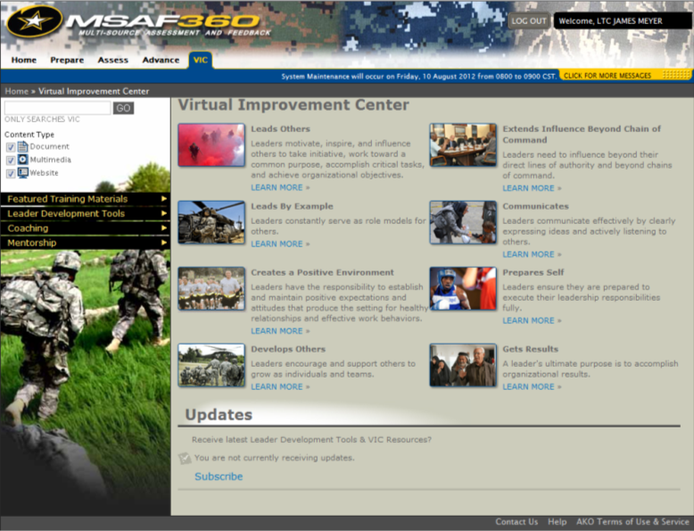
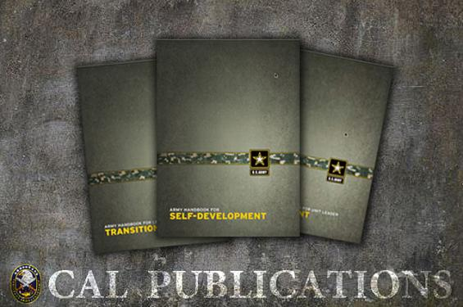
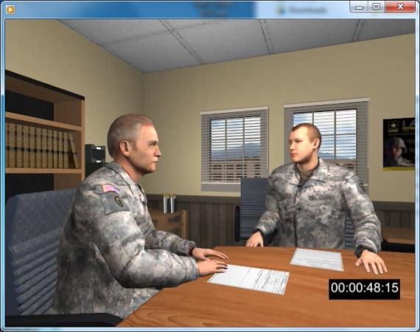
Doctrine/Surveys/PME
MSAF / Leadership Products
Leader Development Strategy & Plan
ADP/ADRP 6-22 Army Leadership
ADP 6-22, approved by the CSA, introduces Army leadership principles
ADRP 6-22 provides detailed explanations of principles in ADP 6-22
CAL’s Annual Survey of Army Leadership (CASAL)
Conducted Annual since 2005
Assess and track trends in Army leader attitudes about:
leader development
the quality of leadership
the contribution of leadership to
mission accomplishment
Survey is completed by approximately:
20,000 uniformed (active/reserve)
3,000 civilian respondents
Provides feedback to leadership (ATLDC)
Provides reports to the field
Other CAL Surveys and Research
Bounds of Effective Leadership
BDE Commander Leadership Requirements
Leadership Curriculum for PME
Proponent for leadership common core tasks and lessons for BOLC, MLC CCC, and CCFSC
PME Stakeholders include:
TRADOC Deputy Commanding General for Initial Military Training (DCG-IMT)
School of Advanced Leadership and Tactics (SALT)
TRADOC Institute for NCO Professional Development (INCODP)
School of Command Preparation (SCP)
Provides development feedback to individuals on Army Leadership Competencies (ADP/ADRP 6-22)
Provides feedback to organizations (unit roll up reports)
Provides aggregate feedback to the institutional army
Purpose: to increase self-awareness and facilitate leader development
Required for all Leaders: officer, NCO & Civilian
Approximately 150,000 Army active duty, reserve, guard, and civilian assessments since inception in 2007
Leadership Products and Services
Self-Development materials
Handbooks for unit leaders
Army Leader Development Strategy
Under revision
Aligned to CCJO, JOE 2010, ACC, AOC, FM1, ADP 3-0 and ADP 6-22
Recognizes Paradigm Shifts and Identifies imperatives
Articulates desired leader characteristics over time
Applies to all cohorts/components
Includes supporting Imperative & Army Profession Annexes
ALDS Implementation Plan
Army Leader Development Plan
Imperatives Annex
Army Profession Annex
Army Training and Leader Development Guidance
Update to DA PAM 350-58
Policy and Regulation alignment
Initative Management and Integrated Priority List (IPL)
Governance – Army Leader Development Forum
Army Campaign Plan Major Objective

